Slide 1

Fuzzing / Automated Testing
Offensive Computer Security
FSU CS Dept
Spring 2014

Slide 2
“Any sufficiently advanced bug is indistinguishable from a feature”
-Rich Kulawiec
Quoted in ch3 “Exploratory Software Testing” by James A Whittaker

Slide 3

Outline
Bugs
Testing
Fuzzing
CS Theory
Test Harness
More Fuzzing
Taint Analysis

Slide 4

Two types of testing
General Testing
Regression testing
developer written use cases
spec-focused use cases
Random Testing
fuzzing (The topic of this lecture)
fuzzing may find more bugs than all other forms of testing

Slide 5
Challenges of Testing
How do we verify that the software performed correctly given arbitrary test cases?
Right output?
Side effects?
These rely on quality specifications

Slide 6
Challenges of Testing
Can we distinguish bugs from features?
in product’s specs / documentation???
if not, is testing impossible?
If bug symptoms are so subtle that:
they evade automated testing
they evade manual testing…
is testing useless?

Slide 7
(Hopefully) Prior to Testing
Well documented code / written specs
TDD (Testing Driven Development)
Test cases written by developers
Usually totally insufficient
Security aware developers
So rare overall…
Specifically explained testing expectations
non-existent. period.

Slide 8
In Reality
All companies ship software that contains bugs
Most testing is not concerned with security
across the spectrum / in general
Quantity of bugs vs Quality of bugs found…
Like security, Testing efforts aren’t appreciated if there is a major failure

Slide 9

In Reality
You will always have bugs that you just cant reproduce

Slide 10
A Honest Job Ad for a Tester
“Software tester wanted. Position requires comparing an insanely complicated, poorly documented product to a nonexistent or woefully incomplete specification. Help from original developers will be given grudgingly. Product will be used in environments that vary wildly with multiple users, multiple platforms, multiple languages, and other requirements yet unknown but just as important. We’re not quite sure how to define them, but security and performance are paramount, and post release failures are unacceptable and could cause us to go out of business”
QTD in “Exploratory Software Testing” by James A Whittaker

Slide 11
Discovering Vulnerabilities
Three Primary Methods:
Source Code Auditing
Requires source code
Reverse Engineering
Can be done without source code.
need binaries
hard
Fuzzing
Lots of tools / frameworks exist
Easy to make custom ones
Binary or source code availability is unimportant

Slide 12
Discovering Vulnerabilities
Three Primary Methods:
Source Code Auditing (static)
Reverse Engineering (static)
Fuzzing (dynamic)
There are other methods to keep in mind:
Dynamic Taint Analysis / Data flow (dynamic)
Forward Symbolic (aka Concolic) Execution (dynamic)
Other Static Analysis techniques
…

Slide 13
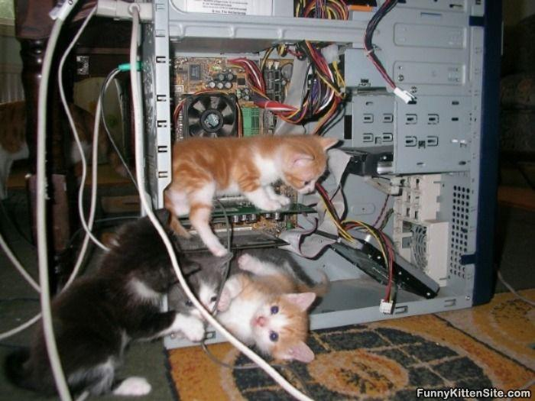
Discovering Vulnerabilities
Fuzzing primarily finds bugs.
not all bugs are vulnerabilities.
finding exploitable bugs.

Slide 14
What is fuzzing?
The (repeated) process of sending specific data to an application, in hope to elicit certain responses
Specific?
Mutated data, generational data, edge cases, unanticipated datatypes, etc.
Certain?
crashes, errors, anomalous behavior, different application states...

Slide 15
Why?
Used effectively for:
Bug Hunting
finding vulnerabilities (good guys & bad guys)
fame & profit (pwn2own ~$150k for first place)
Software testing (SDL)
important to Google, Mozilla, Microsoft, Apple, etc.

Slide 16
Fuzzing Phases
Identify inputs of application
Generate fuzzed data
We’ll cover 3 methods
Mutation
Generation
Differential
Execute Fuzzed Data
Monitor for Exceptions
Determine Exploitability

Slide 17
Methods for generating fuzzed data
Mutational fuzzing:
starts with known good "template" and seed which is then modified (by the fuzzing algorithm).
Output is limited by the template and seed
anything that is NOT in the template or seed will not be generated
i.e. take existing file and corrupt (mutate) parts of it and test application with it (over and over)

Slide 18

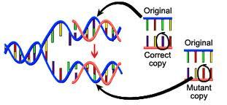
Methods for generating fuzzed data
Mutational fuzzing limits:
fuzzing only as good as starting data samples
low entropy / complexity starting samples won’t usually cover interesting code paths

Slide 19
Methods for generating fuzzed data
Generational fuzzing:
Capable of building the data being sent based on data model constructed by the fuzzer author
sometimes simple, dumb, or random
but can be highly efficient if written to combine good values in interesting ways
i.e. you figure out the protocol / format and write code to generate it.

Slide 20
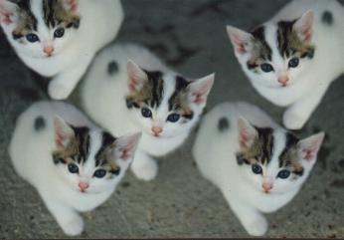
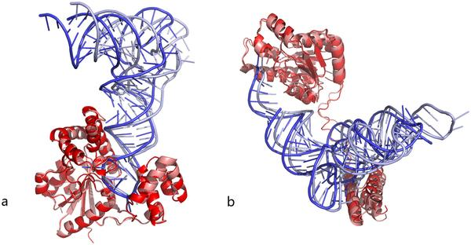
Methods for generating fuzzed data
Generational fuzzing limits:
There are infinite unaccepted inputs to a program, and to each stage of a code path.
limit = your understanding of the input / constraints

Slide 21
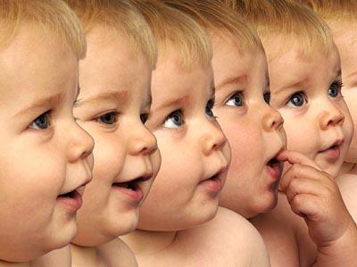
Methods for generating fuzzed data
Generational fuzzing limits:
Your generator is only as good a your understanding of the protocol / format
harder to generate very complex protocols

Slide 22
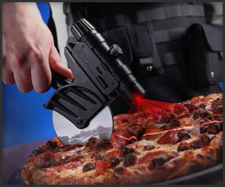
Methods for generating fuzzed data
Differential fuzzing:
Any fuzzing algorithm that actively reduces the testing state space (other than plain exhausting it)
focuses on automating test-case reduction
focused on code path coverage
Trims the state space
constraint recognition
heuristics

Slide 23
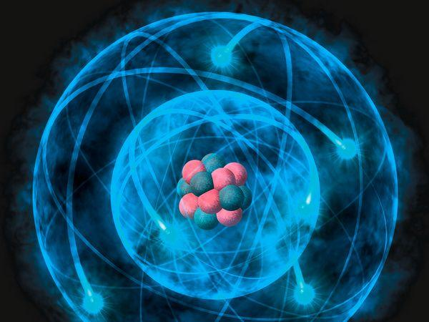
The Eddington Number
1.57×10⁷⁹
(approx 10⁸⁰)

Slide 24
Computer Science Theory
Space complexity
if you try to generate and store > 10⁸⁰
Fail
if you iterate through > 10⁸⁰
Possible & Slow + need algorithm to determine success
Crashes
Taint Analysis (later in this lecture)

Slide 25
Computer Science Theory
Space complexity Example
HD Picture (1920x1080)
represented by html-friendly hex triplet:
byte 1: red values
byte 2: green
byte 3: blue
Each pixel represents 256³ colors == 16,777,216.
Fuzzing the whole space: 16,777,216^{(1920 * 1080)}

Slide 26
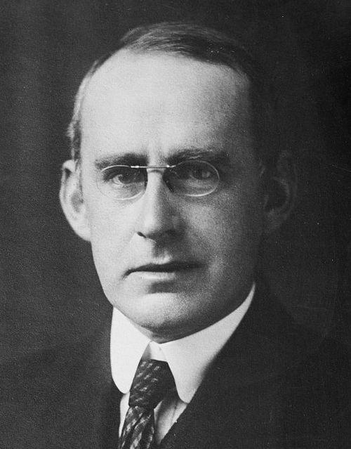
Computer Science Theory
1.50041... × 10¹⁴⁹⁸¹¹⁷⁹ > 10⁸⁰
Some things are not feasible to exhaustively test or fuzz.
thus there will ALWAYS be bugs
for sufficiently large programs
Important to target efforts.
Sir Arthur Eddington
(famous astrophysicist)

Slide 27
Computer Science Theory
Time Complexity
Fuzzing is often parallelizable
huge help for dealing with time complexity
If your fuzzer is O(n^{x}) or significantly larger than O(n) you are probably doing it wrong.

Slide 28
A Fast File Fuzzer tool
http://rmadair.github.com/fuzzer/
Python based mutational file fuzzer.
Uses PyDBG to monitor for signals of interest
Client / Server architecture...

Slide 29
A Fast File Fuzzer tool
http://rmadair.github.com/fuzzer/
Client / Server architecture
any number of clients can connect to the server
each client handles some portion of the fuzzing
creates mutated files clientside to fuzz a local copy of the target program with
can distribute fuzzing in a cloud like fashion
split up the set of all the things to fuzz over each client, and run them all in parallel

Slide 30

Recap (Fuzzing)
Mutational
Generational
Differential

Slide 31
Dynamic Analysis Basics / Fuzzing Test Harness
b/c fuzzing things without paying attention to them is a waste of time

Slide 32
(white box) generating crashes
Crashes?
Very easy to Detect
Logic Flaws?
Very hard to detect. generally infeasible. Rice’s Theorem
Fuzz
Detect
exceptional behavior
Determine if bug
Determine if Vulnerability

Slide 33
(white box) Test Harness
Test harness for crashes:
check if process died
check if process zombied
check PID gone
check logs
attach debugger, check process state

Slide 34
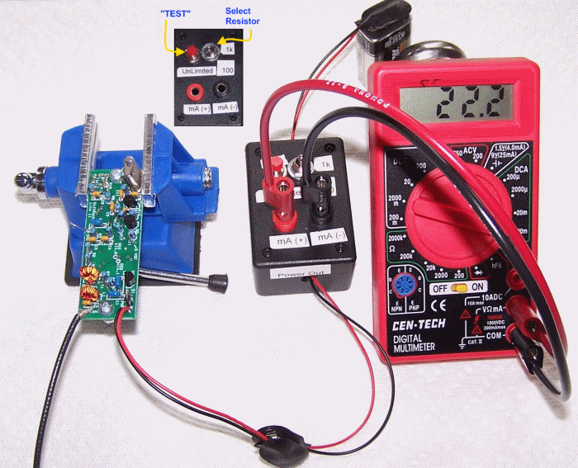
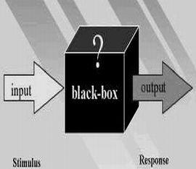
(black box) Introspection
Can you even get access of any form?
Can you view it’s process state?
can you even view output?
can you even detect crashes?

Slide 35
Our homework
To build your own fuzzer and find bugs / vulns in a popular application
then ethically disclose bugs / vulns to vendor

Slide 36
Guidance on Fuzzing

Slide 37
Fuzzing in General
The fuzzed input must be:
common enough to pass elementary checks
i.e. basic constraints
uncommon enough to trigger exceptional behavior

Slide 38
Constraints
if (x > 10U)
//dangerous code
//safe code

Slide 39
Constraints
if (x ^ 0x012345 || strcmp(“SECRET KEY”, y))
{
//path 1
} else {
//path 2
}

Slide 40
BASIC CONSTRAINTS
int main(int argc, char* argv[]){
if (argc != 9) {
exit(1);
}
//rest of code
}

Slide 41
“QUALITY” Constraints
int foo(int x, char* data[]){
if(x == complex_type){
// do very complex operation on data[]
…
} else {
// do really simple operation on data[]
}

Slide 42
“QUALITY” Constraints
int foo(int x, char* data[]){
if(x == complex_type){
// do very complex operation on data[]
…
} else {
// do really simple operation on data[]
}
KEEP THIS IN MIND AS WE GET TO CODE PATHS

Slide 43
Other “QUALITY” Constraints
Bit packing
Remember how this influences the logic of free() / unlink?
Hard to detect logic bugs via fuzzing
Frequent in very low level code
Size or last 4 bytes of previous
Size of this chunk |  |  |  | P
data
data
data
Last 4 bytes of user data
Size of next chunk |  |  |  | 1

Slide 44
Types of Targets & Goals
Environment Variables
Positional Arguments, flags, etc.
File formats
Network protocols
Web apps
etc...

Slide 45
Types of Targets & Goals
Exploit/Attacker Goals:
corrupt code/"business" logic
Arbitrary/Malicious code execution
permission escalation
shell spawning / reverse shell
etc..

Slide 46
5 properties to test (micro scale)
inputs
state(s)
code paths
user data
environment

Slide 47
5 properties to test (micro scale)
Independently fuzzing each is insufficient:
inputs
state(s)
code paths
user data
environment
Lets consider some examples

Slide 48
Thoughts on fuzzing
Web Page: Add / Delete users (code path) may only be available to admin (state)
thus fuzz also flags/values in the cookie
Browsers/VMs/Java: Just in time (JIT) compilation and execution (code paths) heavily depend on global engine state

Slide 49
Thoughts on fuzzing
Protocols: Get protocol to a specific [state], then send unusual state change packets (data) to it

Slide 50
Testing Inputs
0,1,2,3… -1, -2 … ?
2, 4, 1024, 4096, …
other atomic values?
practically infinite
Or abstract inputs
Input length
Min / Max values and +/- edge case testing

Slide 51
Generating fuzzed data
What type of data should one fuzz an application with?
Integer values
Border (edge) cases:
0, 0xFFFFFFFF (2^32)
Leverage +n or -n cases
malloc (.... + 1)

Slide 52
Generating fuzzed data
Ranges:
• MAX32 – 16 <= MAX32 <= MAX32 + 16
• MAX32 / 2 – 16 <= MAX32 / 2 <= MAX32 / 2 + 16
• MAX32 / 3 – 16 <= MAX32 / 3 <= MAX32 / 3 + 16
• MAX32 / 4 – 16 <= MAX32 / 4 <= MAX32 / 4 + 16
• MAX16 – 16 <= MAX16 <= MAX16 + 16
• MAX16 / 2 – 16 <= MAX16 / 2 <= MAX16 / 2 + 16
• MAX16 / 3 – 16 <= MAX16 / 3 <= MAX16 / 3 + 16
• MAX16 / 4 – 16 <= MAX16 / 4 <= MAX16 / 4 + 16
• MAX8 – 16 <= MAX8 <= MAX8 + 16
• MAX8 / 2 – 16 <= MAX8 / 2 <= MAX8 / 2 + 16
• MAX8 / 3 – 16 <= MAX8 / 3 <= MAX8 / 3 + 16
• MAX8 / 4 – 16 <= MAX8 / 4 <= MAX8 / 4 + 16
Try to influence signed / unsigned values: char short, int, long, etc.
Unsigned value: 2^X
Signed value: 2^X / 2

Slide 53
Generating fuzzed data, cont
String repetitions:
A*10, A*100, A*1000
$./program $(perl -e 'print "A" x1000')
$./program $(python -c 'print "A"*1000')
Not just 'A', 'B' makes a difference on the heap, and in hard coded anti-reversing checks!
like in CTFs

Slide 54
Generating fuzzed data, cont
Delimiters
!@#$%^&*()-_=+{}|\;:’”,<.>/?~`
Varying length strings separated by delims
increasing length of delimiter:
User::::::::::::::::::::::::::::password

Slide 55
Generating fuzzed data, cont
Format Strings
%s and %n have greatest chance to trigger a fault
%s dereferences a stack value
%n writes to a pointer (another dereference)
Should fuzz long sequences (i.e. to cause crashes)

Slide 56
Generating fuzzed data, cont
Character translations
0xfe and 0xff are expanded into 4 characters under UTF16
0xcc and 0xcd modifiers super and sub accents for UTF8 extended encodings:

Slide 57
Generating fuzzed data, cont
Character translations
for instance: U̱̲ͫ́͗͆̽̈̆͞Ş͇̼̜̊̌ͮ̈̀̓̈
unpacked and decoded in python, this is: 'U','\xcd','\xab','\xcc','\x81','\xcd','\x97','\xcd','\x86','\xcc','\xbd','\xcc','\x88','\xcc','\x86','\xcd','\x9e','\xcc','\xb1','\xcc','\xb2','S','\xcc','\x8a','\xcc','\x8c','\xcd','\xae','\xcc','\x88','\xcc','\x80','\xcd','\x83','\xcc','\x88','\xcc','\xa7','\xcd','\x87','\xcc','\xbc','\xcc','\x9c'
see http://www.utf8-chartable.de/unicode-utf8-table.pl?start=768&number=128&names=-&utf8=0x

Slide 58
Multi-byte characters
On multi-byte chars containing escape chars:
https://breaktech.etherpad.mozilla.org/7
How to find these? Need to iterate through all character sets.

Slide 59
Generating fuzzed data, cont
Directory Traversal:
targeting web apps,network daemons, etc
../../ and ..\..\ etc...
important to try different character encoding (%5C = '\' in unicode)

Slide 60
Generating fuzzed data, cont
Metacharacter / Command Injection
when targeting web apps, cgi scripts, network daemons
&&, ; --' “ ” , > < ! % $() and | characters

Slide 61
Generating fuzzed data, cont
File types
spoof magic number (unix)
2-byte identifier at the beginning of a file
.gif's have magic numbers of GIF87a or GIF89a
spoof file extension
old file extension types (i.e. .php3 instead of .php)
content-meta data (in web traffic)
i.e. via intercept proxy
special folders (windows mainly)

Slide 62
Poly-File Types
http://code.google.com/p/corkami/downloads/detail?name=CorkaMIX.zip&can=2&q=
Proof of Concept to generate a file that is a valid PE, PDF, HTML (+ java script), AND .JAR (with Python) file!

Slide 63
Generating fuzzed data, cont (Networking)
Modeling Arbitrary Network Protocols
What if SMTP or a proprietary protocol is tunneled over HTTP to your web app?
or over SSH
or over DNS
Bit flipping for protocol headers / flags
Fuzz with network time syncing protocols
perhaps to attack crypto on a network service :D
in use since 1985

Slide 64
Generating fuzzed data, cont (Networking)
Modeling Unknown Network Protocols
Turns out that Bio-Mathematical pattern mapping techniques work quite well for detecting structures of protocols
very helpful for modelling them, building state machine, and generating the protocol given sample traffic
See Offensive Network Security for more!

Slide 65
Crash Analysis /
Taint Analysis
Once crashes are caused, determining if a vulnerability exists

Slide 66
Taint Analysis
Goal is to mark data originating from untrusted sources as tainted
can be done statically / dynamically
Two dependencies that determine taint:
Data flow dependencies
Control flow dependencies

Slide 67
Data flow dependencies
//x is tainted
y = 2;
z = x + y;
//z is tainted
From: http://diyhpl.us/~bryan/papers2/paperbot/e15bb28f0dc692c053f64bb48b879ab3.pdf

Slide 68
Control flow dependencies
//x is tainted
if (x > 1) y = 1 else y =2;
//y is tainted b/c influenced by x
From: http://diyhpl.us/~bryan/papers2/paperbot/e15bb28f0dc692c053f64bb48b879ab3.pdf

Slide 69
Taint Tracking Policies
Just track data flow dependencies?
Also control flow dependencies?
Track taint after free() / garbage collection?
miss use after free or use uninitialized vulns.
bytewise?
or even bitwise?

Slide 70
Taint Analysis
System
User Input
STACK
CPU
?
Shared Libraries
REGISTERS
HEAP
HD / RAM
Data
text

Slide 71
Taint Analysis
EIP?
EDI?
...
System
User Input
STACK
CPU
?
Shared Libraries
REGISTERS
HEAP
HD / RAM
Data
text

Slide 72
Taint Analysis
System
HELLO WORLD
STACK
CPU
?
Shared Libraries
REGISTERS
HEAP
Data
text
d14a028c2a3a2bc9476102bb288234c415a2b01f828ea62ac5b3e42f

Slide 73
Taint Analysis (For Differential Cryptanalysis)
System
HELLX WORLD
STACK
CPU
This is a toy example
?
Shared Libraries
REGISTERS
HEAP
Data
text
d14a028c2a3a2bc9476102bb288234c415a2b01f828ea62ac5b3e42f

Slide 74
Taint Analysis
Partial writes / Full writes
operations like shifts, and, nand, ...
ones that destroy information
Stop tracking taint when
variable overwritten by static /const value
var assigned from untainted ojbect

Slide 75
Simple Taint Analysis
User inputs are non-repeating patterns:
Aa0Aa1Aa2Aa3Aa4Aa5Aa6Aa7Aa8Aa9Ab0Ab1Ab2Ab3Ab4Ab5Ab6Ab7Ab8Ab9Ac0Ac1Ac2Ac3Ac4Ac5Ac6Ac7Ac8Ac9Ad0Ad1Ad2Ad3Ad4Ad5Ad6Ad7Ad8Ad9Ae0Ae1Ae2Ae3Ae4Ae5Ae6Ae7Ae8Ae9Af0Af1Af2Af3Af4Af5Af6Af7Af8Af9Ag0Ag1Ag2Ag3Ag4Ag5...

Slide 76
Simple Taint Analysis
Check if registers at crash contain any of these patterns(ENDIANNESS MATTERS HERE!)
EIP = 5Af6 (big endian) f65A (little endian)
RIP = Ag1Ag2Ag (big endian) Agg21AAg (little endian (x86))
If confused, see (http://en.wikipedia.org/wiki/Endianness)

Slide 77
Taint Analysis (For Differential Cryptanalysis)
System
HELLX WORLD
STACK
CPU
This is a toy example
?
Shared Libraries
REGISTERS
HEAP
Data
text
d14a028c2a3a2bc9476102bb288234c415a2b01f828ea62ac5b3e42f

Slide 78
Problem
Patterns won’t work in all applications
method fails on any transforms of user input
encoding / decoding / expansion /etc…

Slide 79

Questions?
MORE NEXT TIME!!
Read: Differential Testing for Software (http://www.cs.dartmouth.edu/~mckeeman/references/DifferentialTestingForSoftware.pdf)
Read Adaptive Random Testing (http://www.utdallas.edu/~ewong/SYSM-6310/03-Lecture/02-ART-paper-01.pdf)
Read: Attaching the Rocket to the Chainsaw https://www.cert.org/blogs/certcc/2013/09/putting_the_rocket_on_the_chai.html

Slide 80
http://blog.regehr.org/archives/1039

Slide 81
BFF
Basic Fuzzing Framework (Linux / Mac)
http://www.cert.org/vulnerability-analysis/tools/bff.cfm

Slide 82
FOE
Failure Observation Engine (Windows fuzzing)
http://www.cert.org/vulnerability-analysis/tools/foe.cfm

